Slide 1
CLASSIFICATION TREES – KNN NAÏVE BAYES – SVM - ANN

Slide 2
BACKGROUND
Decision tree (DT) is one of the most popular machine learning algorithms used for both classification and regression problems. Today we are going to talk about the use of DT for classification, so let’s get started!!!
We have couple of other algorithms there, so why do we have to choose Decision trees?? Well, there might be many reasons but I believe a few which are
Decision tress often mimic the human level thinking so its so simple to understand the data and make some good interpretations.
Decision trees actually make you see the logic for the data to interpret(not like black box algorithms like SVM,NN,etc..)

Slide 3
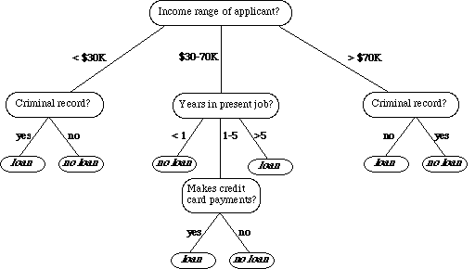
WHAT DOES IT LOOK LIKE ?
As it is shown on the left, DT which is used for classifying bank loan application for a customer may look like this.
Here we can see the logic how it is making the decision. It’s simple and clear.
A DT is a tree where each node represents a feature(attribute), each link(branch) represents a decision(rule) and each leaf represents an outcome
The whole idea is to create a tree like this for the entire data and process a single outcome at every leaf.

Slide 4
SOME OF ALGORITHMS
There are couple of algorithms there to build a decision tree , we only talk about a few which are
ID3 (Iterative Dichotomiser 3) → uses Entropy function and Information gain as metrics.
CART (Classification and Regression Trees) → uses Gini index(Classification) as metric.
Lets just first build decision tree for classification problem using above ID3 algorithm.

Slide 5
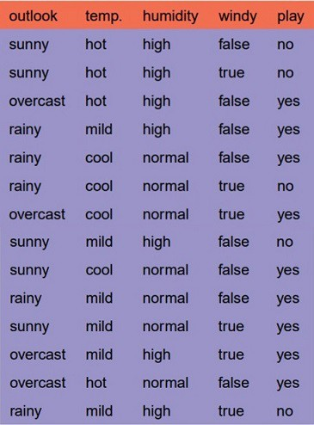
ID3 ALGORITHM : EXAMPLES
We have four X values (outlook, temp, humidity and wind) being categorical and one y value (play Y or N) also being categorical.
So we need to learn the mapping (what machine learning always does) between X and y.
This is a binary classification problem, lets build the tree using the ID3 algorithm
To create a tree, we need to have a root node first and we know that nodes are features/attributes
So which one do we need to pick first??

Slide 6
ID3 ALGORITHM : EXAMPLES
1.Compute the entropy for data-set
2.for every attribute/feature:
calculate entropy for all categorical values
take average information entropy for the current attribute
calculate gain for the current attribute
3. pick the highest gain attribute.
4. Repeat until we get the tree we desired.

Slide 7
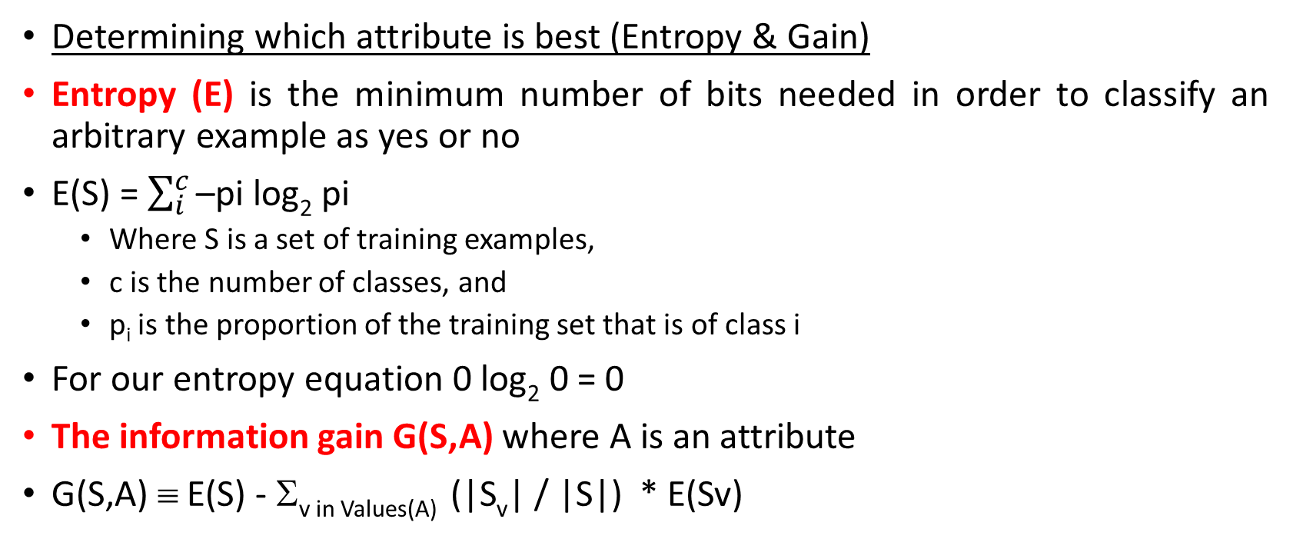
ID3 ALGORITHM : EXAMPLES
Determining which attribute is best (Entropy & Gain)
Entropy (E) is the minimum number of bits needed in order to classify an arbitrary example as yes or no
E(S) = $\sum_{i}^{c}{\text{–}\text{pi} \text{log}\text{2} \text{pi}}$
Where S is a set of training examples,
c is the number of classes, and
p_{i} is the proportion of the training set that is of class i
For our entropy equation 0 log₂ 0 = 0
The information gain G(S,A) where A is an attribute
G(S,A) ≡ E(S) - Σ_{v in Values(A)} (|S_{v}| / |S|) * E(Sv)

Slide 8
Let’s Try an Example!
Let
E([X+,X-]) represent that there are X positive training elements and X negative elements.
Therefore the Entropy for the training data, E(S), can be represented as E([9+,5-]) because of the 14 training examples 9 of them are yes and 5 of them are no.
Let’s start off by calculating the Entropy of the Training Set.
E(S) = E([9+,5-]) = (-9/14 log₂ 9/14) + (-5/14 log₂ 5/14) = 0.94
Next we will need to calculate the information gain G(S,A) for each attribute A where A is taken from the set {Outlook, Temperature, Humidity, Wind}.
The information gain for Outlook is:
G(S,Outlook) = E(S) – [5/14 * E(Outlook=sunny) + 4/14 * E(Outlook = overcast) + 5/14 * E(Outlook=rain)]
G(S,Outlook) = E([9+,5-]) – [5/14*E(2+,3-) + 4/14*E([4+,0-]) + 5/14*E([3+,2-])]
G(S,Outlook) = 0.94 – [5/14*0.971 + 4/14*0.0 + 5/14*0.971]
G(S,Outlook) = 0.246

Slide 9
The information gain for Temperature:
G(S,Temperature) = 0.94 – [4/14*E(Temperature=hot) + 6/14*E(Temperature=mild) + 4/14*E(Temperature=cool)]
G(S,Temperature) = 0.94 – [4/14*E([2+,2-]) + 6/14*E([4+,2-]) + 4/14*E([3+,1-])]
G(S,Temperature) = 0.94 – [4/14 + 6/14*0.918 + 4/14*0.811]
G(S,Temperature) = 0.029
The information gain for Humadity:
G(S,Humidity) = 0.94 – [7/14*E(Humidity=high) + 7/14*E(Humidity=normal)]
G(S,Humidity = 0.94 – [7/14*E([3+,4-]) + 7/14*E([6+,1-])]
G(S,Humidity = 0.94 – [7/14*0.985 + 7/14*0.592]
G(S,Humidity) = 0.1515
The information gain for Windy:
G(S,Windy) = 0.94 – [8/14*0.811 + 6/14*1.00]
G(S,Windy) = 0.048

Slide 10
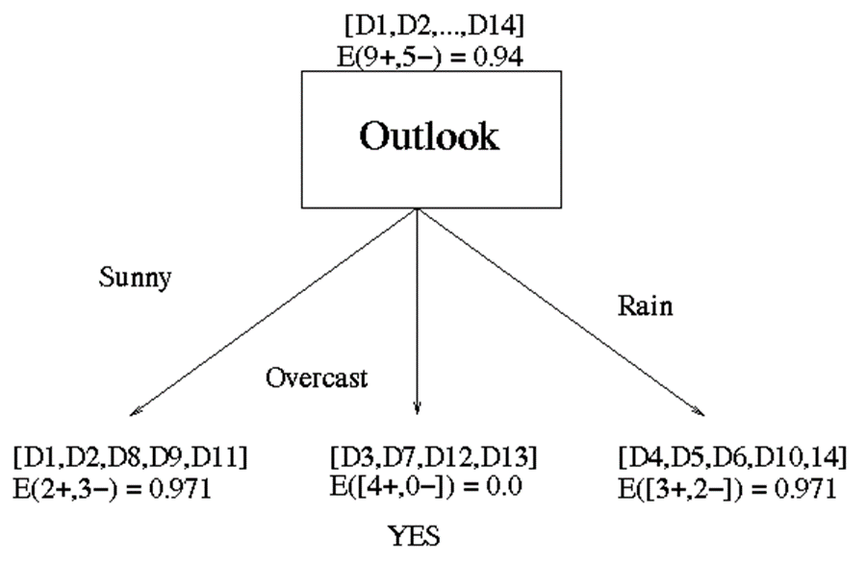
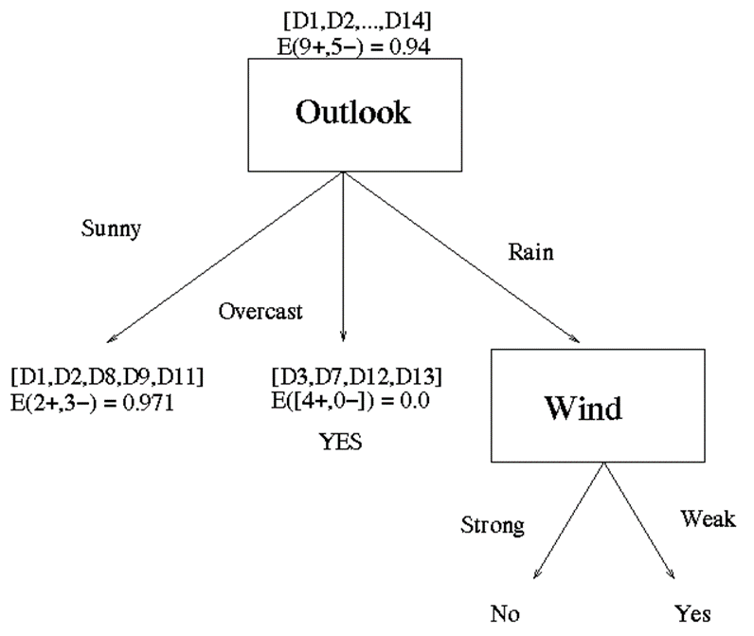
Outlook is the winner
Now that we have discovered the root of our decision tree we must now recursively find the nodes that should go below Sunny, Overcast, and Rain.
G(Outlook=Rain, Humidity) = 0.971 – [2/5*E(Outlook=Rain & Humidity=high) + 3/5*E(Outlook=Rain & Humidity=normal]
G(Outlook=Rain, Humidity) = 0.02
G(Outlook=Rain,Windy) = 0.971- [3/5*0 + 2/5*0]
G(Outlook=Rain,Windy) = 0.971

Slide 11
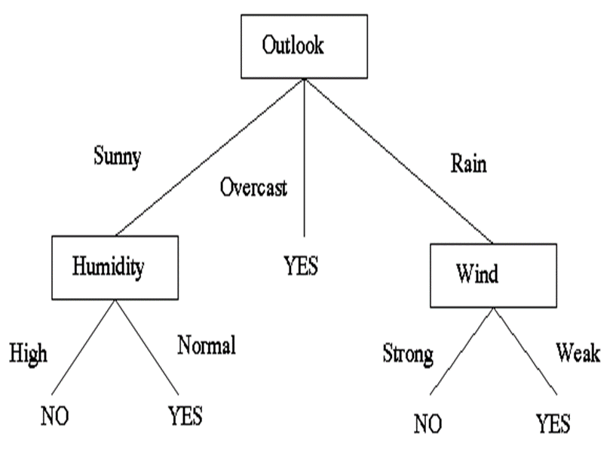
(Outlook = Sunny ∧ Humidity = Normal) ∨ (Outlook = Overcast) ∨ (Outlook = Rain ∧ Wind = Weak)
[See: Tom M. Mitchell, Machine Learning, McGraw-Hill, 1997]

Slide 12
SUPPORT VECTOR MACHINE : LINEAR CLASSIFIERS
α
x
f
y^{est}
f(x,w,b) = sign(w x + b)
denotes +1
denotes -1
How would you classify this data?

Slide 13
α
Linear Classifiers
x
f
y^{est}
f(x,w,b) = sign(w x + b)
denotes +1
denotes -1
Any of these would be fine..
..but which is best?

Slide 14
α
Linear Classifiers
x
f
y^{est}
f(x,w,b) = sign(w x + b)
denotes +1
denotes -1
How would you classify this data?
Misclassified
to +1 class

Slide 15
α
α
Classifier Margin
Classifier Margin
x
x
f
f
y^{est}
y^{est}
f(x,w,b) = sign(w x + b)
f(x,w,b) = sign(w x + b)
denotes +1
denotes -1
denotes +1
denotes -1
Define the margin of a linear classifier as the width that the boundary could be increased by before hitting a datapoint.
Define the margin of a linear classifier as the width that the boundary could be increased by before hitting a datapoint.

Slide 16
α
Maximum Margin
x
f
y^{est}
Maximizing the margin is good according to intuition and PAC (Prob. Approx. Correct) theory
Implies that only support vectors are important; other training examples are ignorable.
Empirically it works very very well.
f(x,w,b) = sign(w x + b)
denotes +1
denotes -1
The maximum margin linear classifier is the linear classifier with the, um, maximum margin.
This is the simplest kind of SVM (Called an LSVM)
Support Vectors are those datapoints that the margin pushes up against
Linear SVM

Slide 17
Linear SVM Mathematically
x⁺
M=Margin Width
“Predict Class = +1” zone
X⁻
wx+b=1
“Predict Class = -1” zone
wx+b=0
wx+b=-1
What we know:
w . x⁺ + b = +1
w . x⁻ + b = -1
w . (x⁺-x⁻⁾ = 2

Slide 18
Linear SVM Mathematically
Goal: 1) Correctly classify all training data
if y_{i} = +1
if y_{i} = -1
for all i
2) Maximize the Margin
same as minimize
We can formulate a Quadratic Optimization Problem and solve for w and b
Minimize
subject to

Slide 19


Solving the Optimization Problem
The Lagrange tells us to subtract the cost function by the summation over all constraints where each of those constraints will be multiplied by some constant α.
L = $\frac{1}{2} \left\|w\right\|2− \sum_{i}^{m}{α_{i}\left[y_{i}\left(w.x+b\right) −1\right]}$
$\frac{δL}{δw}=0 →$ w =
$\frac{δL}{δb}$ = 0 $→ \sum_{1}^{m}{α_{i}}y^{i}$ = 0
$$\sum_{1}^{m}{α_{i}y^{i}x^{i}}$$

Slide 20



Once we solve for alphas we need to be able to use our classifier. That means we need the coefficients of our hyperplane. To get back our coefficients w we can use below equation that we derived earlier:
Once we have our w we can use the fact that for any of the support vectors we have:
And we can solve this for our b coefficient:

Slide 21
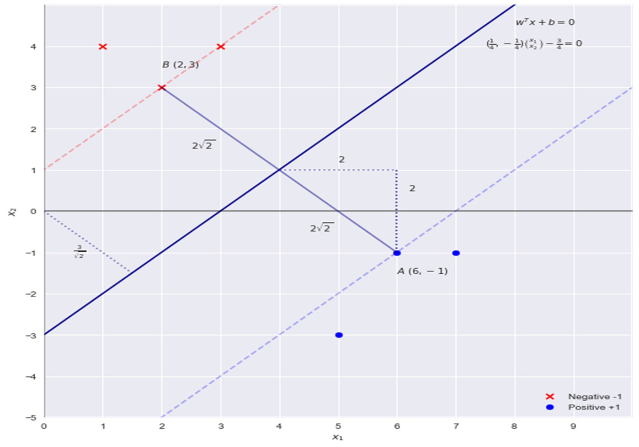
LET’S SEE AN EXAMPLE : FINDING THE HARD MARGIN

Slide 22

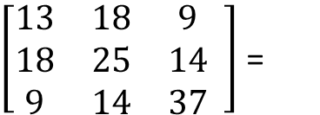
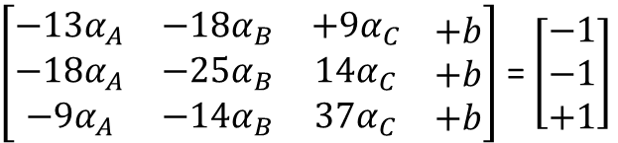
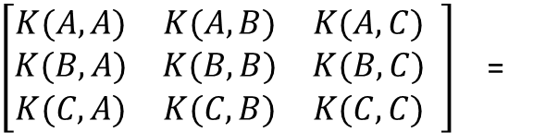
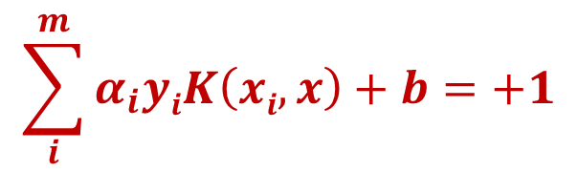
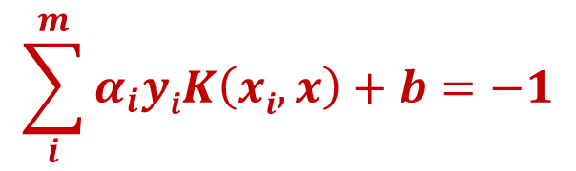
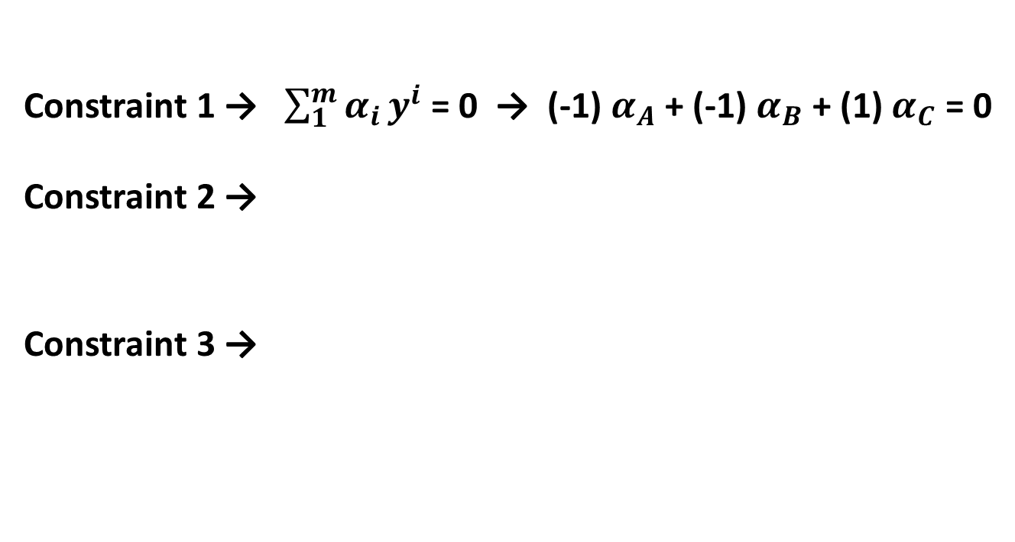
Support Vectors = A[2,3], B[3,4], C[6,-1] Class = [-1, -1, 1 ]
Constraint 1 → $\sum_{1}^{m}{α_{i}}y^{i}$ = 0 → (-1) $α_{A}$ + (-1) $α_{B}$ + (1) $α_{C}$ = 0
Constraint 2 →
Constraint 3 →
$$\sum_{i}^{m}{α_{i}yiK\left(xi,x\right)+b=−1}$$
$$\sum_{i}^{m}{α_{i}yiK\left(xi,x\right)+b=+1}$$
KERNELL FOR LINEAR FUNCTION
C 2.1
$\left[\begin{matrix}K(A,A) & K(A,B) & K(A,C) \\ K(B,A) & K(B,B) & K(B,C) \\ K(C,A) & K(C,B) & K(C,C)\end{matrix} \right]$ =
$\left[\begin{matrix}13 & 18 & 9 \\ 18 & 25 & 14 \\ 9 & 14 & 37\end{matrix} \right]$ =
C 2.2
C 3
α_{A} = 1/16 = 0.0625
α_{B} = 0
α_{C} = 1/16 = 0.0625
b = -3/4 = -0.75
C 2.1
$\left[\begin{matrix}−13α_{A} & −18α_{B} & +9α_{C} \\ −18α_{A} & −25α_{B} & 14α_{C} \\ −9α_{A} & −14α_{B} & 37α_{C}\end{matrix} \begin{matrix}+b \\ +b \\ +b\end{matrix}\right]$ = $\left[\begin{matrix}−1 \\ −1 \\ +1\end{matrix}\right]$
W1 = ?
W2 = ?
C 2.2
C 3
C 1
(-1) $α_{A}$ + (-1) $α_{B}$ + (1) $α_{C}$ + 0 b= 0

Slide 23
COMPARING OUR HAND CALCULATION RESULTS WITH RELATED LIBRARY TAKEN FROM SKLEARN.SVM
from sklearn.svm import SVC
X = np.array([[3,4],[1,4],[2,3],[6,-1],[7,-1],[5,-3]] )
y = np.array([-1,-1, -1, 1, 1 , 1 ])
clf = SVC(C = 1e5, kernel = 'linear')
clf.fit(X, y)
print('Indices of support vectors = ', clf.support_)
print('Support vectors = ', clf.support_vectors_)
print('Number of support vectors for each class = ', clf.n_support_)
print('Coefficients of the support vector in the decision function = ', np.abs(clf.dual_coef_))
print('w = ',clf.coef_)
print('b = ',clf.intercept_)
Indices of support vectors = [2 3]
Support vectors = [[ 2. 3.] [ 6. -1.]]
Number of support vectors for each class = [1 1]
Coefficients of the support vector in the decision function = [[0.0625 0.0625]]
w = [[ 0.25 -0.25]] b = [-0.75]

Slide 24
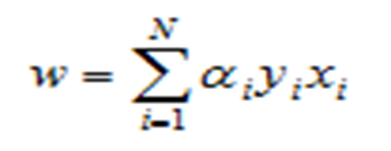

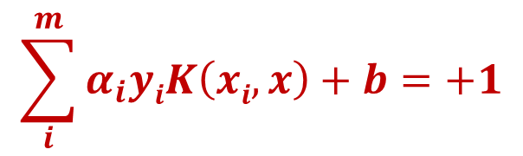
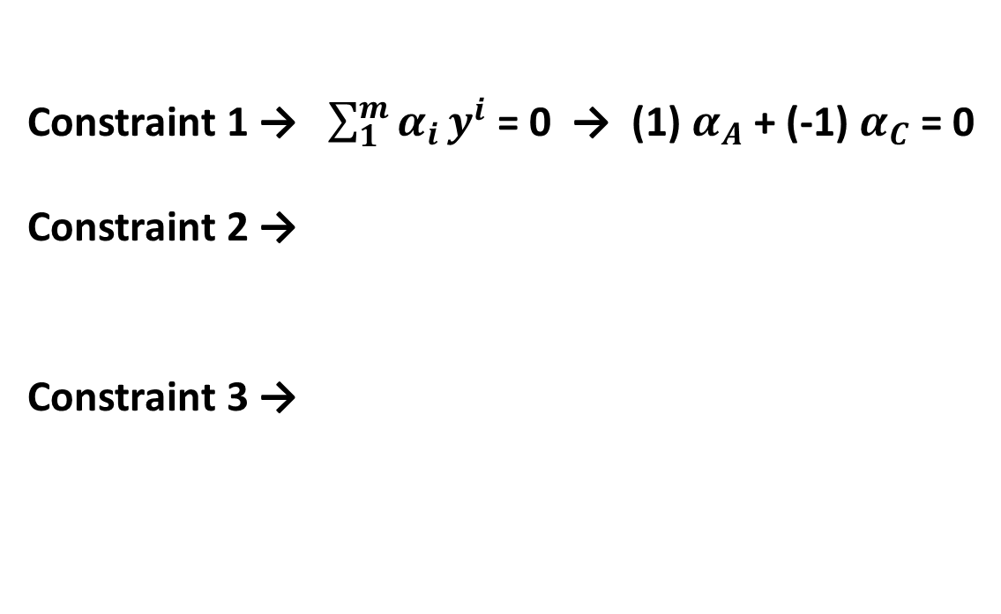




Support Vectors = A[3,4], B[4,1], C[6,6] Class = [1, 1, -1 ]
Constraint 1 → $\sum_{1}^{m}{α_{i}}y^{i}$ = 0 → (1) $α_{A}$ + (-1) $α_{C}$ = 0
Constraint 2 →
Constraint 3 →
$$\sum_{i}^{m}{α_{i}yiK\left(xi,x\right)+b=+1}$$
$$\sum_{i}^{m}{α_{i}yiK\left(xi,x\right)+b=−1}$$
KERNELL FOR LINEAR FUNCTION
C 2
$\left\lceil \begin{matrix}25α_{A} & −42α_{C} & 1 \\ 42α_{A} & −72α_{C} & 1 \\ α_{A} & − α_{C} & 0\end{matrix}\right\rceil$ =
α_{A} = 0.154
α_{C} = 0.154
b = 3.615
$$\left\lceil \begin{matrix} 1 \\ −1 \\ 0\end{matrix}\right\rceil$$
C 3
C 1
$W= .154 \left[\begin{matrix}3 \\ 4\end{matrix}\right] −.154 \left[\begin{matrix}6 \\ 6\end{matrix}\right]$ = $\left[\begin{matrix}−0.462 \\ −0.308\end{matrix}\right]$
$$−.462 X_{1} −.308 X_{2}+3.615=0$$
$$X_{2}=−1.5 X_{1}+11.74$$

Slide 25

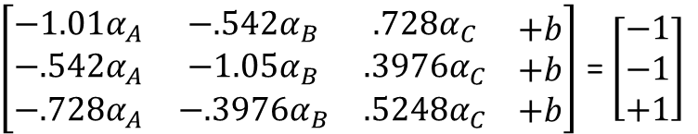
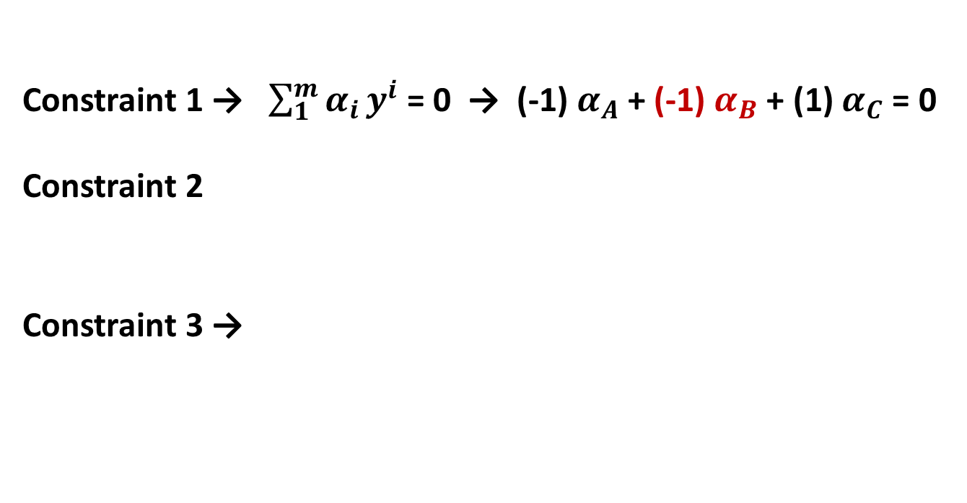
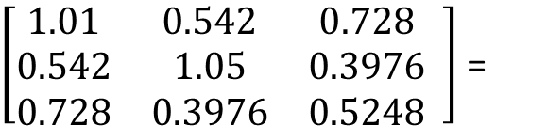
Support Vectors = A[0.1, 1.0], B[.92, 0.45], C[.08, .72] Class = [-1, -1, 1 ]
Constraint 1 → $\sum_{1}^{m}{α_{i}}y^{i}$ = 0 → (-1) $α_{A}$ + (-1) $α_{B}$+ (1) $α_{C}$ = 0
Constraint 2
Constraint 3 →
$$\sum_{i}^{m}{α_{i}yiK\left(xi,x\right)+b=+1}$$
$$\sum_{i}^{m}{α_{i}yiK\left(xi,x\right)+b=−1}$$
KERNELL FOR LINEAR FUNCTION
C 2.1
$\left[\begin{matrix}K(A,A) & K(A,B) & K(A,C) \\ K(B,A) & K(B,B) & K(B,C) \\ K(C,A) & K(C,B) & K(C,C)\end{matrix} \right]$ =
$\left[\begin{matrix}1.01 & 0.542 & 0.728 \\ 0.542 & 1.05 & 0.3976 \\ 0.728 & 0.3976 & 0.5248\end{matrix} \right]$ =
C 2.2
C 3
α_{A} = 28.922
α_{B} = 4.7468
α_{C} = 33.67
b = 6.273
C 2.1
$\left[\begin{matrix}−1.01α_{A} & −.542α_{B} & .728α_{C} \\ −.542α_{A} & −1.05α_{B} & .3976α_{C} \\ −.728α_{A} & −.3976α_{B} & {.5248α}_{C}\end{matrix} \begin{matrix}+b \\ +b \\ +b\end{matrix}\right]$ = $\left[\begin{matrix}−1 \\ −1 \\ +1\end{matrix}\right]$
C 2.2
C 3
C 1
(-1) $α_{A}$ + (-1) $α_{B}$ + (-1) $α_{C}$ + 0 b= 0

Slide 26
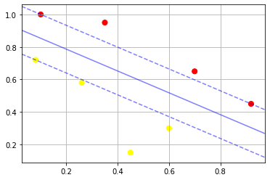

α_{A} = 28.922 (from sklearn.SVC python 28.937)
α_{B} = 4.7468 (from sklearn.SVC python 4.7547)
α_{C} = 33.67 (from sklearn.SVC python 33.69)
b = 6.273 (from sklearn.SVC python 6.275)
$W=−28.92 \left[\begin{matrix}0.1 \\ 1.0\end{matrix}\right] −4.74 \left[\begin{matrix}.92 \\ .45\end{matrix}\right]$ + 33.67 $\left[\begin{matrix}.08 \\ .72\end{matrix}\right]$= $\left[\begin{matrix}−4.5592 \\ −6.8106\end{matrix}\right]$
$$−4.5592 X_{1} −6.8106 X_{2}+6.273=0$$
$$X_{2}=−.67 X_{1}+0.92$$

Slide 27
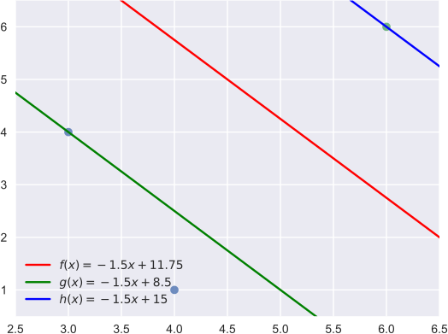
So the hyperplane equations
-0.46153 X1 + (-0,30769 X2) = -3.62538 → f(x) = -1.5 X1 + 11.75
-0.46153 X1 + (-0,30769 X2) = -3.62538 – 1 → g(x) = -1.5 X1 + 15
-0.46153 X1 + (-0,30769 X2) = -3.62538 + 1 → h(x) = -1.5 X1 + 8.5
w = [[-0.46153846 -0.30769231]]
b = [3.61538462]
Indices of support vectors = [2 0]
Support vectors = [[6. 6.]
[3. 4.]]
Number of support vectors for each class = [1 1]
Coefficients of the support vector in the decision function = [[0.15384615 0.15384615]]

Slide 28
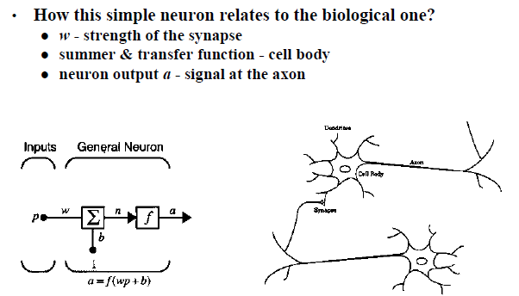
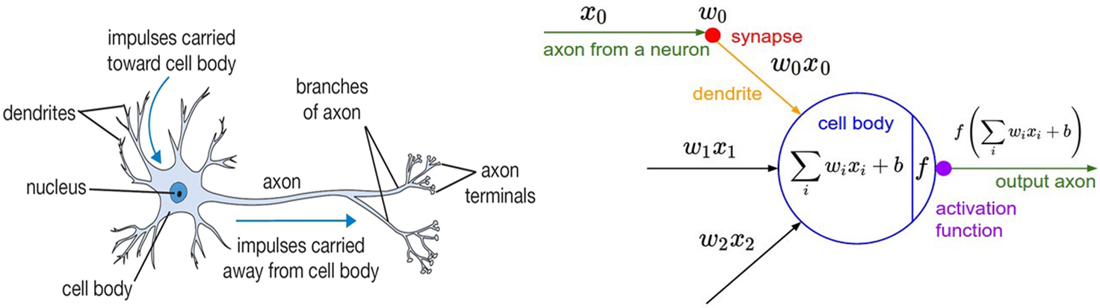
ARTIFICIAL VS BIOLOGICAL NEURON
Notes:
Sources:
https://cs.byu.edu/files/images/neural_networking.jpg

Slide 29
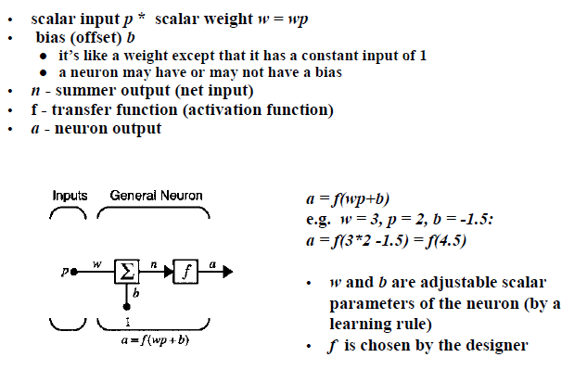
SINGLE-INPUT NEURON

Slide 30
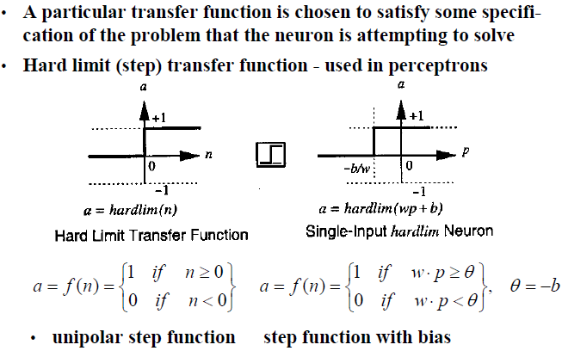
Step Transfer Function

Slide 31
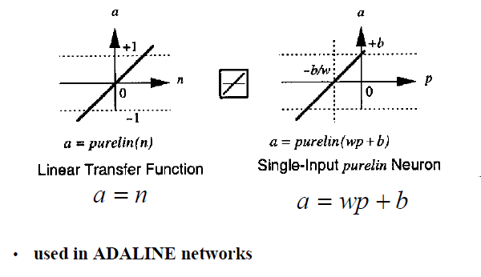
Linear Transfer Function

Slide 32
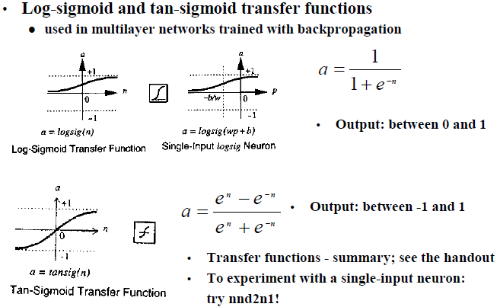
Sigmoid Transfer Function

Slide 33
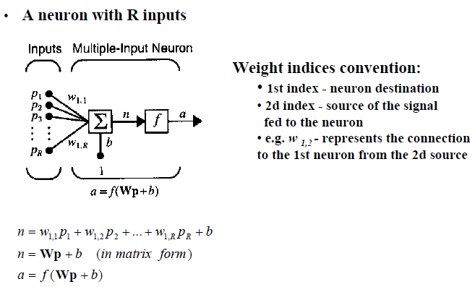
Multiple Input Neuron

Slide 34
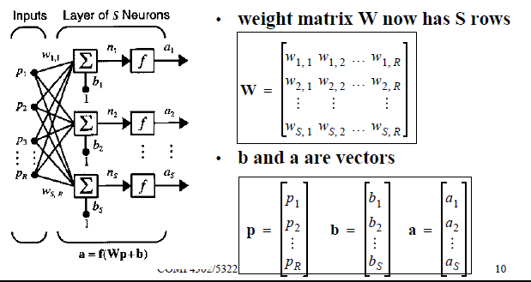
A Layer of Neuron : Network Architectures

Slide 35
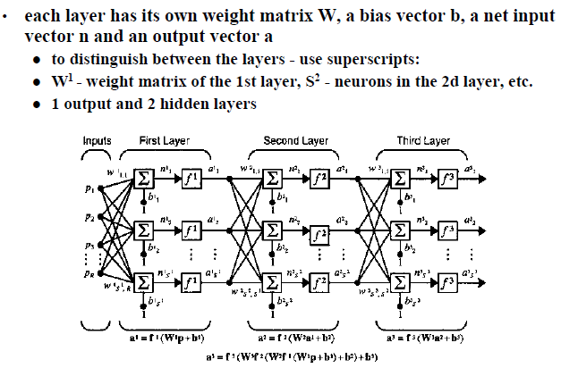
Multilayer Networks

Slide 36
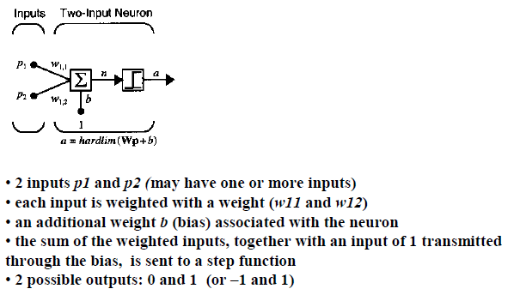
Single-Neuron Perceptron

Slide 37
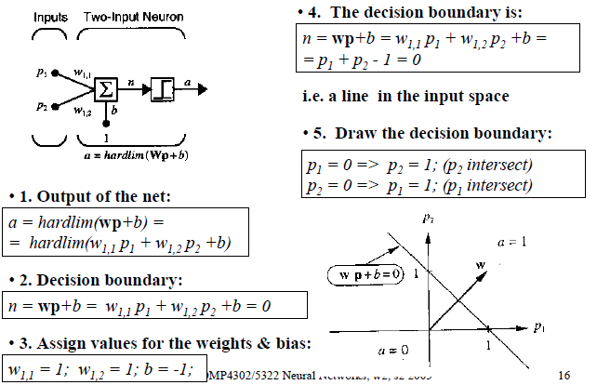
Investigation of the Boundaries

Slide 38
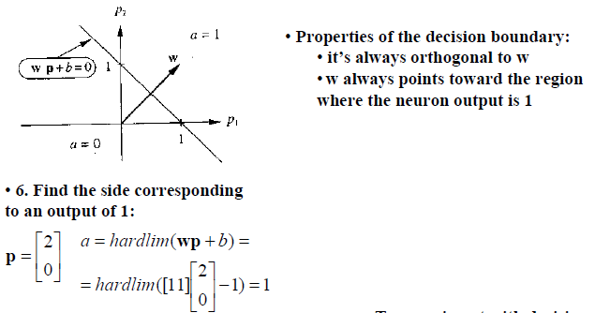
Investigation of the Boundaries

Slide 39
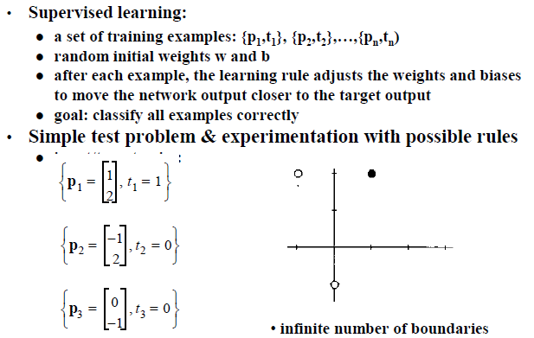
Perceptron Learning Rule - Derivation

Slide 40
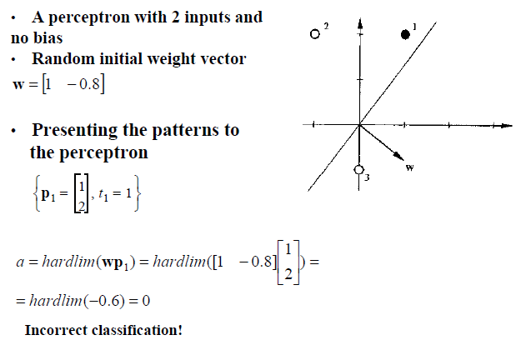
Test Problem – Starting Point

Slide 41
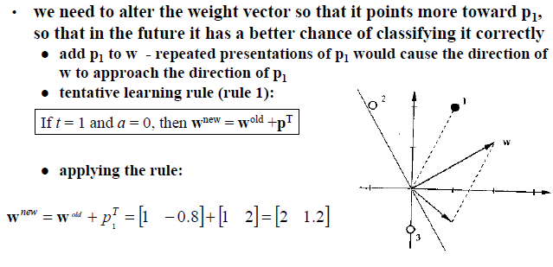
Test Problem – Tentative Learning Rule

Slide 42
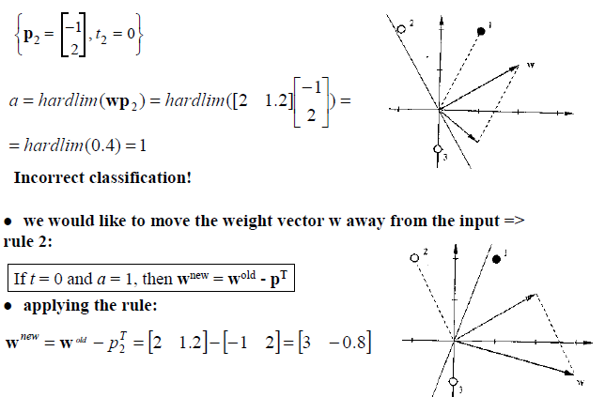
Test Problem – Second Input Vector

Slide 43
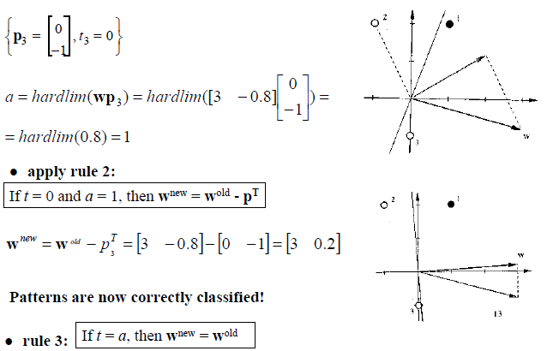
Test Problem – Third Input Vector

Slide 44
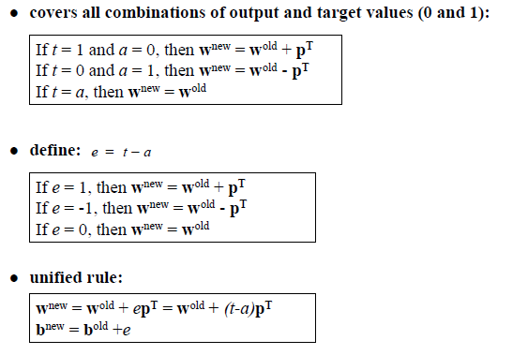
Unified Learning Rule

Slide 45
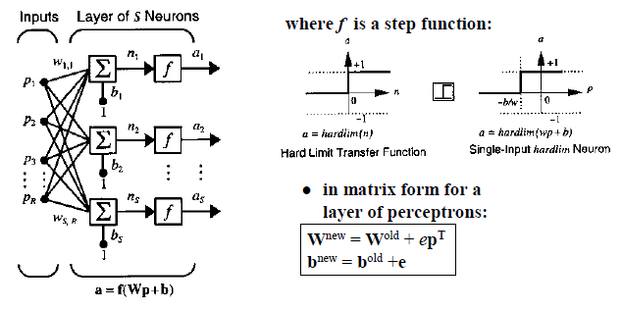
A Layer of Perceptrons

Slide 46
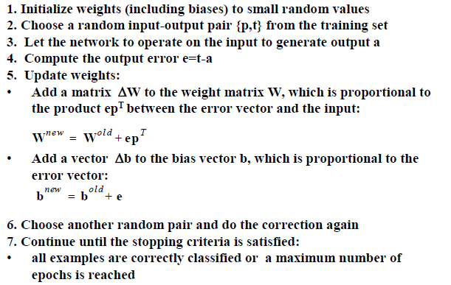
Perceptron Learning Law - Summary

Slide 47
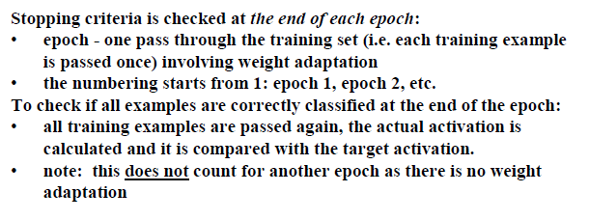
Perceptron – Stopping Criteria

Slide 48
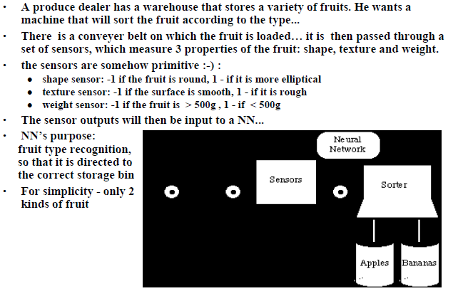
An Example – Apple/Banana Sorter

Slide 49
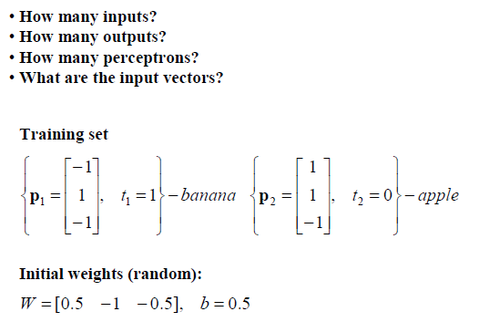
Apple/Banana Example

Slide 50
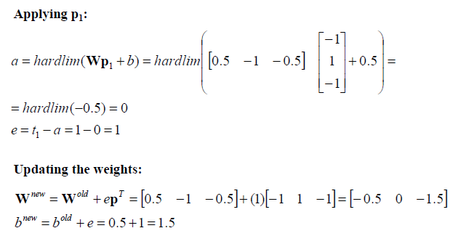
Apple/Banana Example – First Iteration

Slide 51
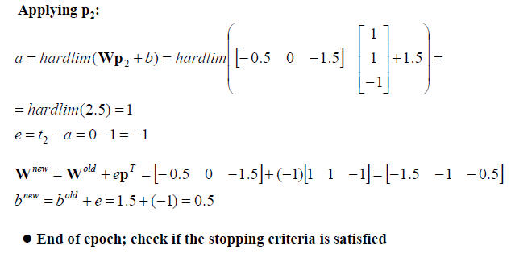
Apple/Banana Example – Second Iteration

Slide 52
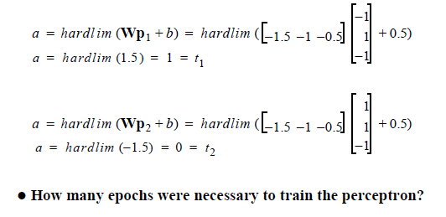
Apple/Banana Example - Check

Slide 53
Prediction Based on Bayes’ Theorem
Given training data X, posteriori probability of a hypothesis H, P(H|X), follows the Bayes’ theorem
Informally, this can be viewed as
posteriori = likelihood x prior/evidence
Predicts X belongs to C_{i} iff the probability P(C_{i}|X) is the highest among all the P(C_{k}|X) for all the k classes
Practical difficulty: It requires initial knowledge of many probabilities, involving significant computational cost

Slide 54
Classification is to Derive the Maximum Posteriori
Let D be a training set of tuples and their associated class labels, and each tuple is represented by an n-D attribute vector X = (x₁, x₂, …, x_{n})
Suppose there are m classes C₁, C₂, …, C_{m}.
Classification is to derive the maximum posteriori, i.e., the maximal P(C_{i}|X)
This can be derived from Bayes’ theorem
Since P(X) is constant for all classes, only needs to maximize:

Slide 55
Naïve Bayes Classifier
A simplified assumption: attributes are conditionally independent (i.e., no dependence relation between attributes):
This greatly reduces the computation cost: Only counts the class distribution
If A_{k} is categorical, P(x_{k}|C_{i}) is the # of tuples in C_{i} having value x_{k} for A_{k} divided by |C_{i, D}| (# of tuples of C_{i} in D)
If A_{k} is continous-valued, P(x_{k}|C_{i}) is usually computed based on Gaussian distribution with a mean μ and standard deviation σ
and P(x_{k}|C_{i}) is

Slide 56
Naïve Bayes Classifier: Training Dataset
Class:
C1:buys_computer = ‘yes’
C2:buys_computer = ‘no’
Data to be classified:
X = (age <=30,
income = medium, student = yes
credit_rating = fair)

Slide 57
Naïve Bayes Classifier: Example
P(C_{i}): P(buys_computer = “yes”) = 9/14 = 0.643
P(buys_computer = “no”) = 5/14= 0.357
Compute P(X|C_{i}) for each class
P(age = “<=30” | buys_computer = “yes”) = 2/9 = 0.222
P(age = “<= 30” | buys_computer = “no”) = 3/5 = 0.6
P(income = “medium” | buys_computer = “yes”) = 4/9 = 0.444
P(income = “medium” | buys_computer = “no”) = 2/5 = 0.4
P(student = “yes” | buys_computer = “yes) = 6/9 = 0.667
P(student = “yes” | buys_computer = “no”) = 1/5 = 0.2
P(credit_rating = “fair” | buys_computer = “yes”) = 6/9 = 0.667
P(credit_rating = “fair” | buys_computer = “no”) = 2/5 = 0.4
X = (age <= 30 , income = medium, student = yes, credit_rating = fair)
P(X|C_{i}) : P(X|buys_computer = “yes”) = 0.222 x 0.444 x 0.667 x 0.667 = 0.044
P(X|buys_computer = “no”) = 0.6 x 0.4 x 0.2 x 0.4 = 0.019
P(X|C_{i})*P(C_{i}) : P(X|buys_computer = “yes”) * P(buys_computer = “yes”) = 0.028
P(X|buys_computer = “no”) * P(buys_computer = “no”) = 0.007
Therefore, X belongs to class (“buys_computer = yes”)

Slide 58
Avoiding the Zero-Probability Problem
Naïve Bayesian prediction requires each conditional prob. be non-zero. Otherwise, the predicted prob. will be zero
Ex. Suppose a dataset with 1000 tuples, income=low (0), income= medium (990), and income = high (10)
Use Laplacian correction (or Laplacian estimator)
Adding 1 to each case
Prob(income = low) = 1/1003
Prob(income = medium) = 991/1003
Prob(income = high) = 11/1003
The “corrected” prob. estimates are close to their “uncorrected” counterparts.

Slide 59
Summary on Naïve Bayes
Advantages
Easy to implement
Good results obtained in most of the cases
Robust to isolated noise points
Handle missing values by ignoring the instance during probability estimate calculations
Robust to irrelevant attributes
Independence assumption may not hold for some attributes
Used by other techniques such as Bayesian Belief Networks (BBN)

